Slide 1
Progress Presentation
Health-Wise Lifespan Assessment using IoT and AI
by
Hardik Sen
Reg No. 210907288
Under the guidance of
Internal Guide External Guide
Prof. Prashant M Prabhu Dr. Spoorthi Singh
ECE, MIT Manipal Mechatronics, MIT Manipal

Slide 2
Recap of Previous Presentation
Introduced the concept of Health-wise Lifespan Assessment using IoT and AI.
Covered literature review, identified the research gap.
Defined project objectives.
Outlined the methodology: IoT, data collection, AI model training.
Discussed project scheduling.

Slide 3
Contents
Introduction
Dataset Creation Process
Dataset Validation & Accuracy Proof
Key Findings
References
Next Presentation Overview

Slide 4
Introduction
Why a Relevant Dataset is Important?
AI models require structured, clean, and relevant data to produce accurate predictions.
In healthcare AI, poor-quality data can lead to incorrect predictions, affecting user health
decisions.
High-quality datasets ensure better generalization and prevent model bias.

Slide 5
Dataset Creation Process
Identified Key Parameters based on WHO reports, Kaggle datasets, and research papers.
Factors: Age, Gender, Country, Smoking, Alcohol Consumption, Diet, Exercise, BMI, Medical History, Work Stress, Social Life.
Gathered Data from real-world research and reports to understand correlations and trends.
Simulated Data where necessary, following real-world statistical patterns.
Structured the Dataset for AI model compatibility and ensured diversity across age, gender, and regions.

Slide 6
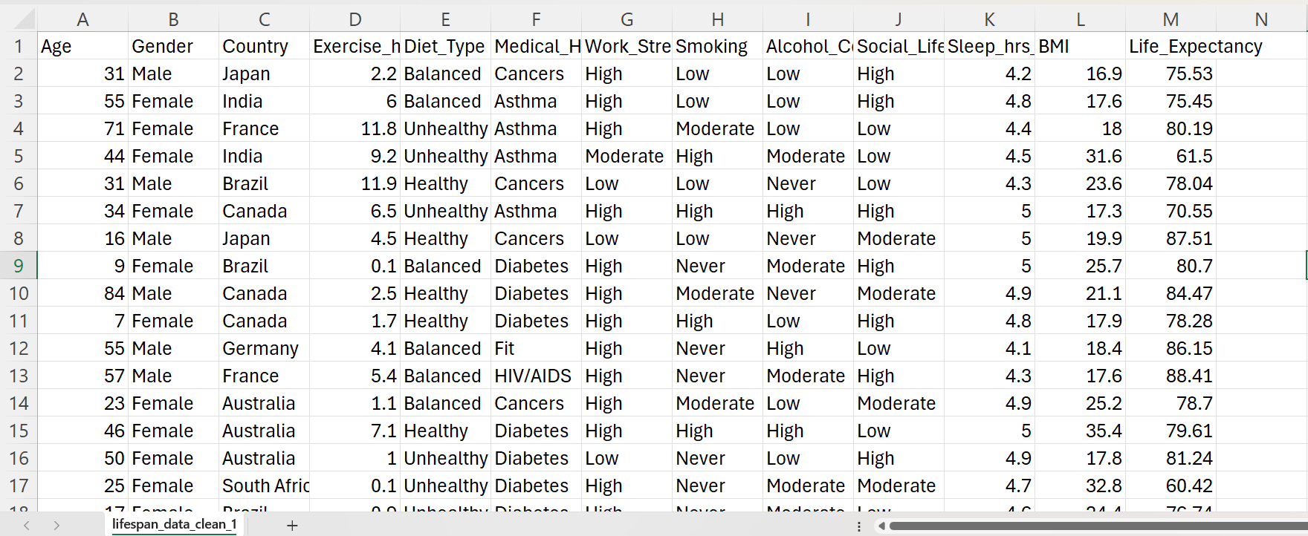
Final Dataset Preview
Dataset contains 5000+ records
Diverse demographics
Structured for AI training

Slide 7
Dataset Validation & Accuracy Proof
Validating Our Dataset Against Research
Ran SQL queries to calculate life expectancy by gender, smoking status, exercise hours, etc.
Correlation Analysis: Exercise hours positively correlated with Life Expectancy.
High Smoking/Alcohol negatively correlated with Life Expectancy.
Compared Our Dataset with WHO and Global Research
Conclusion: Dataset trends align with WHO, Lancet, Harvard, and Kaggle data.

Slide 8
Key Findings
Insights from Dataset Validation
The average lifespan is about 5 years longer for women than men worldwide.
Who exercised for an average of 92 min per week had a 4 year longer life expectancy.
Estimated gains from Healthy dietary changes from an unhealthy diet pattern to the longevity-associated diet pattern were 10.8 years
Life expectancy decreases by 13 years on average for heavy smokers compared to people who have never smoked.
Men who get adequate sleep live about five years longer than men who don’t
Compared with individuals of healthy weight (BMI 18·5–24·9 kg/m2), life expectancy was 6·8 years shorter in obese (BMI ≥30·0 kg/m2) and 8·3 years shorter in underweight (BMI <18·5 kg/m2) men

Slide 9
References
Fadnes, L. T., et al. (2022). "Estimating impact of food choices on life expectancy: A modeling study." PLOS Medicine.
Jha, P., et al. (2013). "21st-century hazards of smoking and benefits of cessation in the United States." The New England Journal of Medicine.
Lu, Y., et al. (2023). "Association of healthy sleep patterns with life expectancy at age 30 years." JAMA Internal Medicine.
Moore, S. C., et al. (2012). "Leisure time physical activity and mortality: A detailed pooled analysis of the dose-response relationship." PLOS Medicine.
The Global BMI Mortality Collaboration. (2016). "Body-mass index and all-cause mortality: Individual-participant-data meta-analysis of 239 prospective studies in four continents." The Lancet.
World Health Organization (WHO), Global Health Observatory (GHO) Data:https://www.who.int/data/gho Kaggle Datasets: https://www.kaggle.com/datasets

Slide 10
Next Presentation Overview
Will demonstrate the AI/deep learning model selection process.
Explained how the model was trained and optimized
Accuracy evaluation.

Slide 11
Thank You

